Slide 1

Happy Insurance Project
Anas Aesa

Slide 2
Project Stages
ETL
Power Pivot
Data loading to Power Query
Creating Dim and Fact Tables
Creating Dim Date Table
Data Cleaning
Creating Connections and Star Scheme via BK and SK keys
Defining Measures and Calculated Columns
Building Dashboard, Graphs and Tables based on the Model
Power BI
Loading the Model into the PBI
Changing names and creating measures table
Hiding unnecessary columns and tables
Creating KPI and Graphs
Exploring the Model using Dax
General Analysis
Getting Insights and analysing the PBI and Power Pivot Dashboars and Graphs
Creating Power Point based on the received information

Slide 3
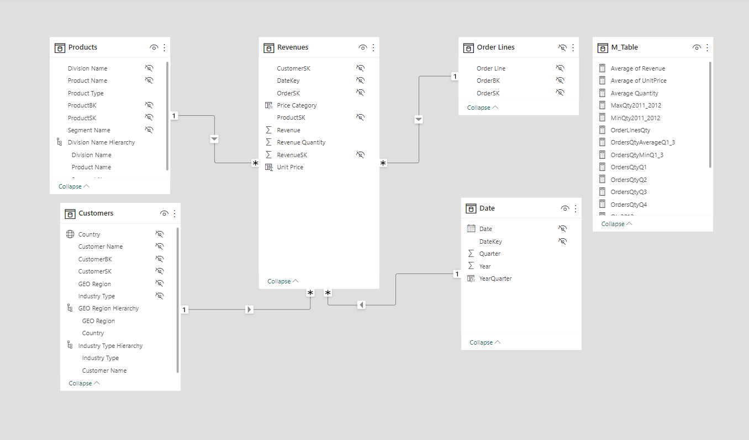
Data Model: Star Schema

Slide 4
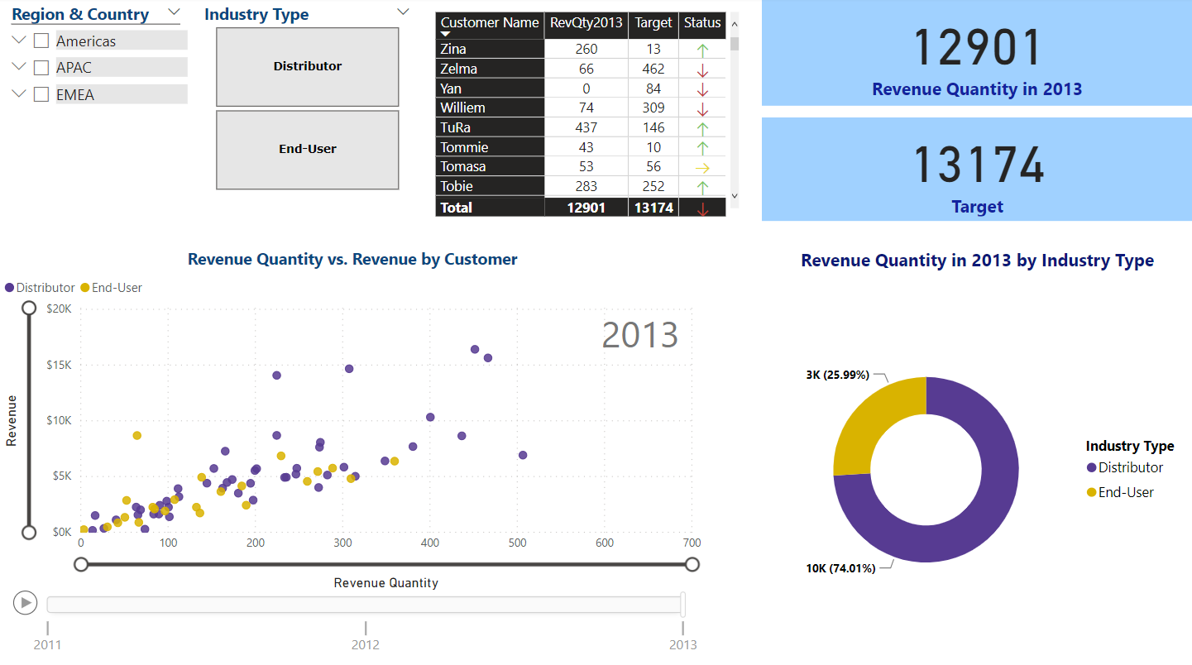
Main Dashboards
This Dashboard gives an information regarding the Revenue quantity, based on the KPI.
In addition, it allows you to see the customers who have helped to achieve the goals.
The information can be checked by Region, Country and Industry Type slicers.

Slide 5
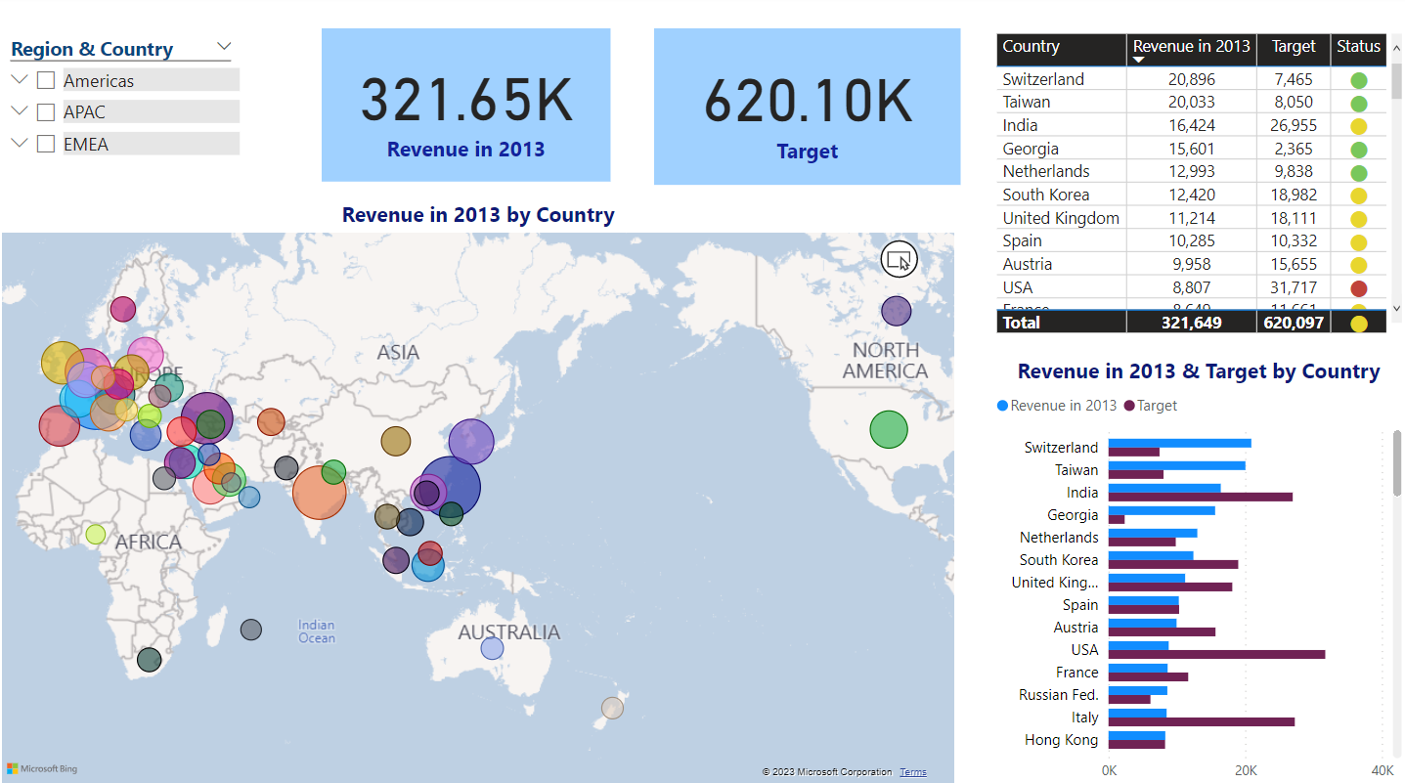
Main Dashboards
This Dashboard allows to see the Regions where the company has received its revenue.
This Dashboard also makes easier to see the most profitable countries from one side and the countries that have not achieved the targeted revenue from another.

Slide 6
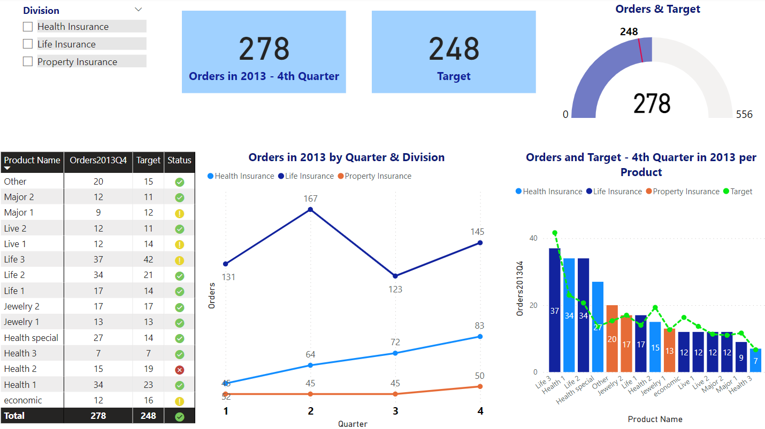
Main Dashboards
This Dashboard allows to see the profitability of the different products comparing to the Target.
In addition, it allows to filter the profitability by Divisions on the Quarter basis.

Slide 7
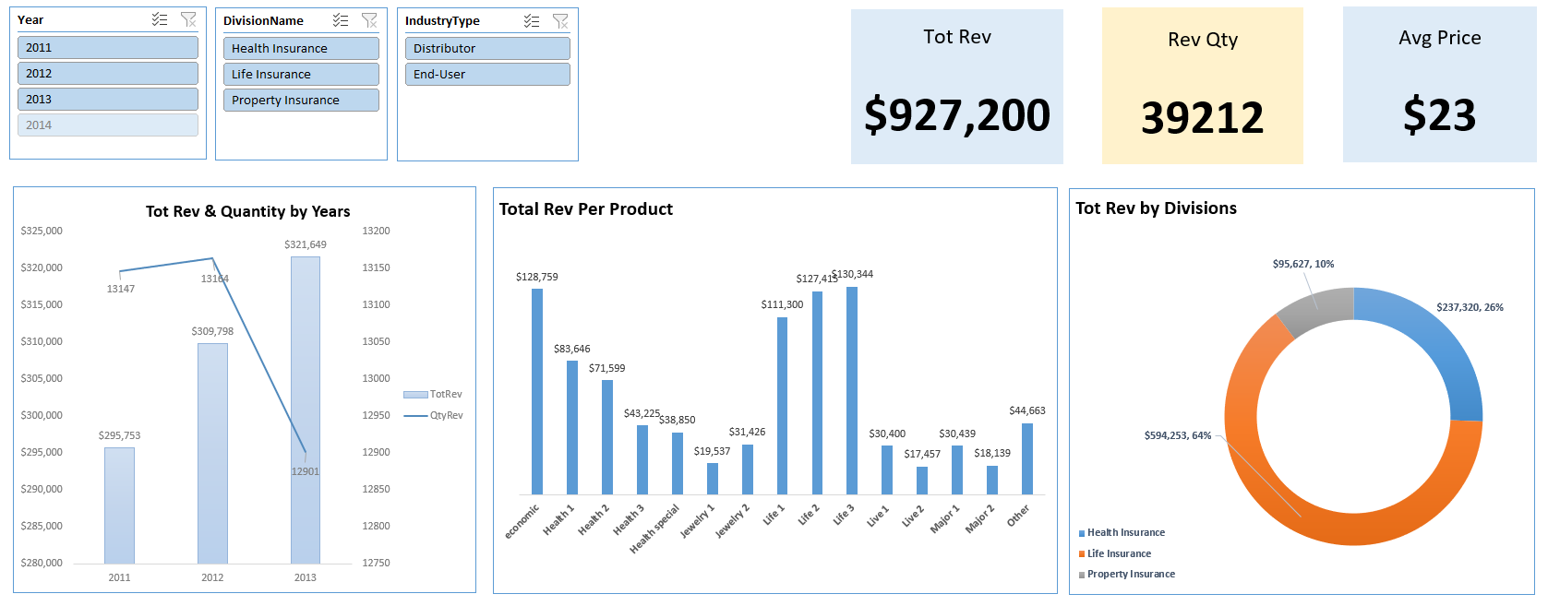
Power Pivot
This Dashboard allows to see the profitability of the different divisions/products/Industry Type by years.

Slide 8
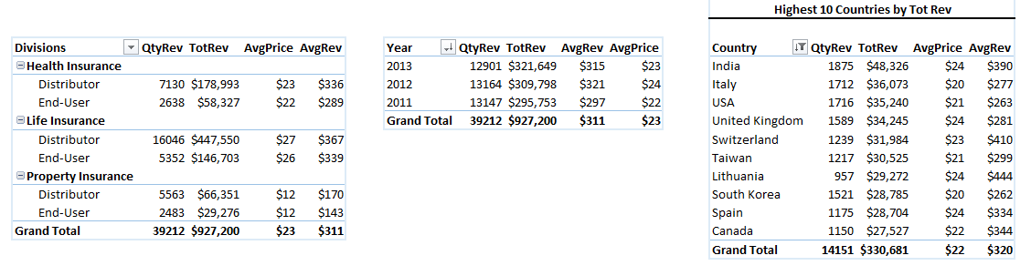
Power Pivot
This Dashboard allows to see the profitability via Excel Tables, which makes it also convenient for the Accounting Department.

Slide 9
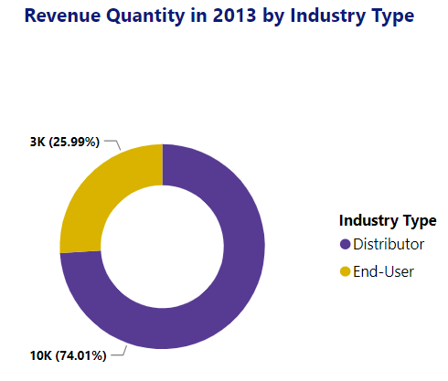
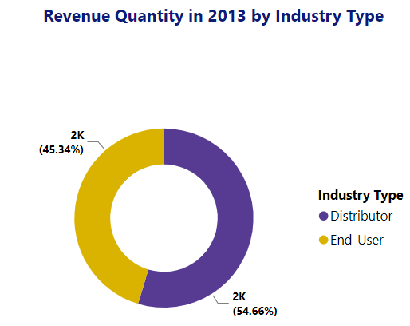
Analysis & Conclusions
Comparing to other regions, where Distributor Industry type sells more product quantities, in APAC region End-User type works mostly the same as the Distributor Type.

Slide 10
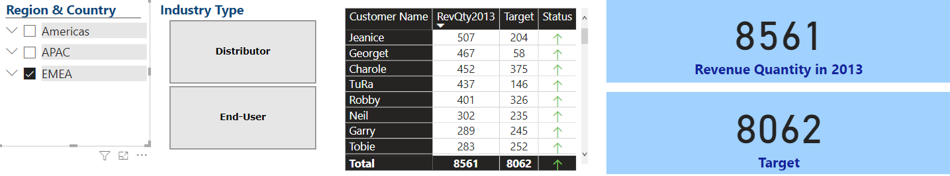
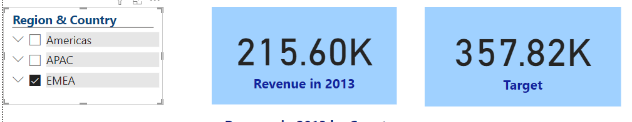
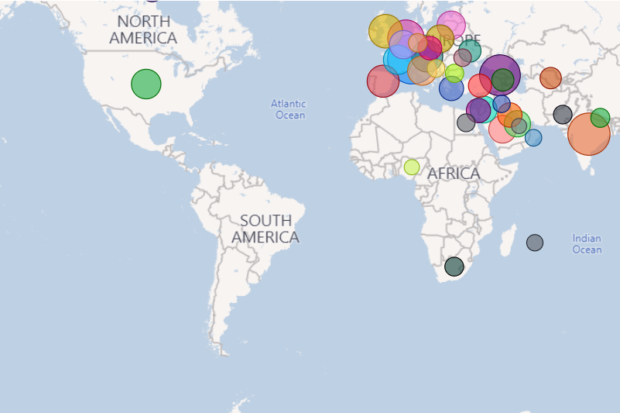
Analysis & Conclusions
Only EMEA Region has overachieved the target for 2013. Other Regions have not achieved the annual goals.
There are top customers who have paid mostly twice revenue that what was projected. It is important to be in touch with them and to mark them as VIP customers.
EMEA is most profitable region, though it has also not achieved the annual revenue goal.
There are no Revenues in South America and mostly there is no revenue in Africa. This direction should be developed.

Slide 11
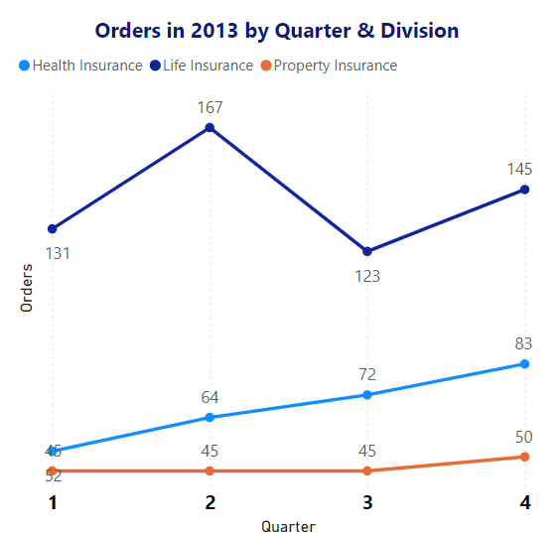
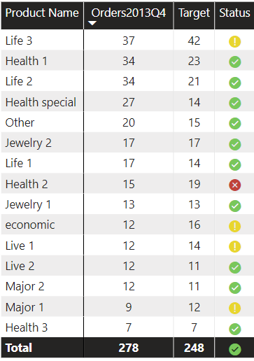
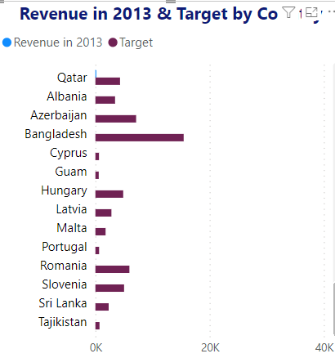
Analysis & Conclusions
There is no Revenue at all from the following countries. The responsible for it should be checked as it was revenue from these countries in 2011 and 2012.
Life insurance division has accomplished most of the orders.
Life 3 is the most popular Product thought it has not achieved the target quantity.

Slide 12
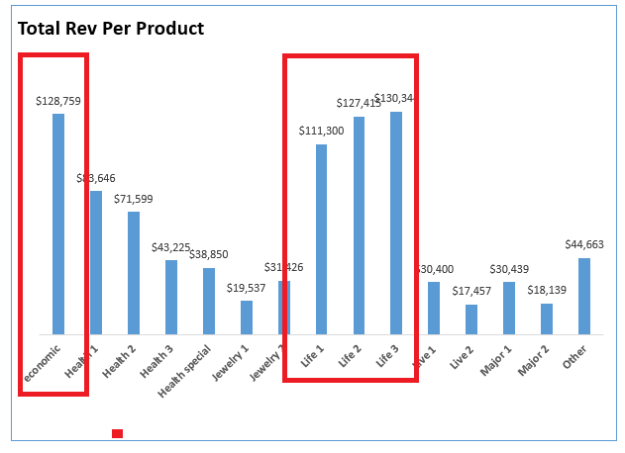
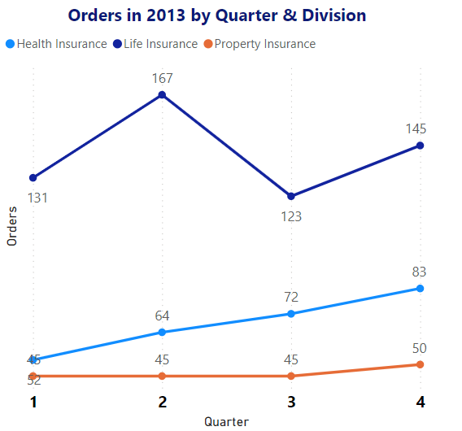
Analysis & Conclusions
Though Life insurance is most profitable Division, it is less stable comparing to other divisions
Life 1, Life 2, Life 3 and economic have brought the highest revenue.

